Slide 1
Microsoft Application Containers For Geeks

Slide 2

Mike Nelson MVP, CTP, vExpert, MAA @nelmedia Family, beer, technology, & food

Slide 3
Discussion
Containers
Docker
Windows & Hyper-V Containers
Azure Containers
Demos

Slide 4
Where does NanoServer fit?
Who manages containers? With What?
What is Docker?
Is it only about DevOps?
What are MicroServices?
What about PowerShell?
What’s the difference between Windows Containers & Hyper-V Containers?
How does this affect me & my career?
Why would you use containers?
Where can containers be run?
What apps can run in containers?

Slide 5

What are containers?
Containers are Operating System-level Virtualization.
Containers encapsulate applications into individual isolated environments on a shared operating system with their own processes, network, binaries, and libraries.

Slide 6
1979 chroot Unix V7
2000 BSD Jails & Solaris Zones
2008 LXC
2006 Process Containers
2013 Docker
2016 Rocket v1
2016 Windows / Hyper-V Containers & Docker for Windows & Mac
2015 Azure Containers

Slide 7
“It is all about the applications.”
Why Containers:
Are not just for DevOps anymore!
Reduce Development “friction”
“Throw-away” components
Deploy really, really, really fast
Dev Frameworks are diverse – “Works on my machine”
Are extremely compact & lightweight
Density, density, and more density
Reusable and portable
Have an “Open” Standard. Well… kinda.
Management is simple, but mostly CLI for now
Have a massive EcoSystem – like really, really big.

Slide 8
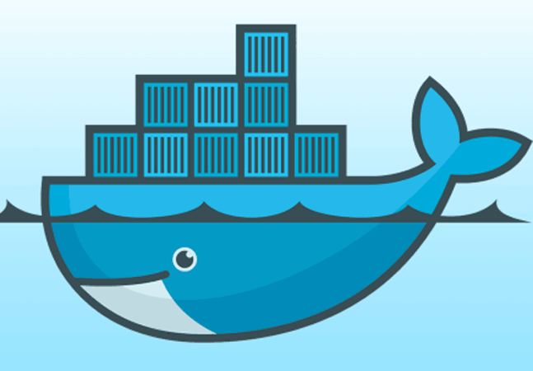

What is docker?
Docker is an open platform container technology. It is a management, api, host, and packaging platform for containers.
Docker has a huge ecosystem of applications & services that allow for growth, scale, resiliency, and redundancy.
NOT THE ONLY GAME IN TOWN ANYMORE…
Windows Containers

Slide 9
Hypervisor Architectures
Hardware
Hypervisor
Guest 1
Guest 2
Hardware
Hypervisor
Guest 1
Guest 2
Host OS
Type 1
Type 2

Slide 10
VM vs Containers Architecture
App A
App B
Container
App A
App B
App A¹
App B¹
App B²
App C
VM
Bins / Libs
Bins / Libs
Hardware
Hypervisor
Guest 1
Guest 2
Host OS
Bins / Libs
Bins / Libs
Hardware
Container Engine
Host OS

Slide 11
Density
OS Cost

Slide 12
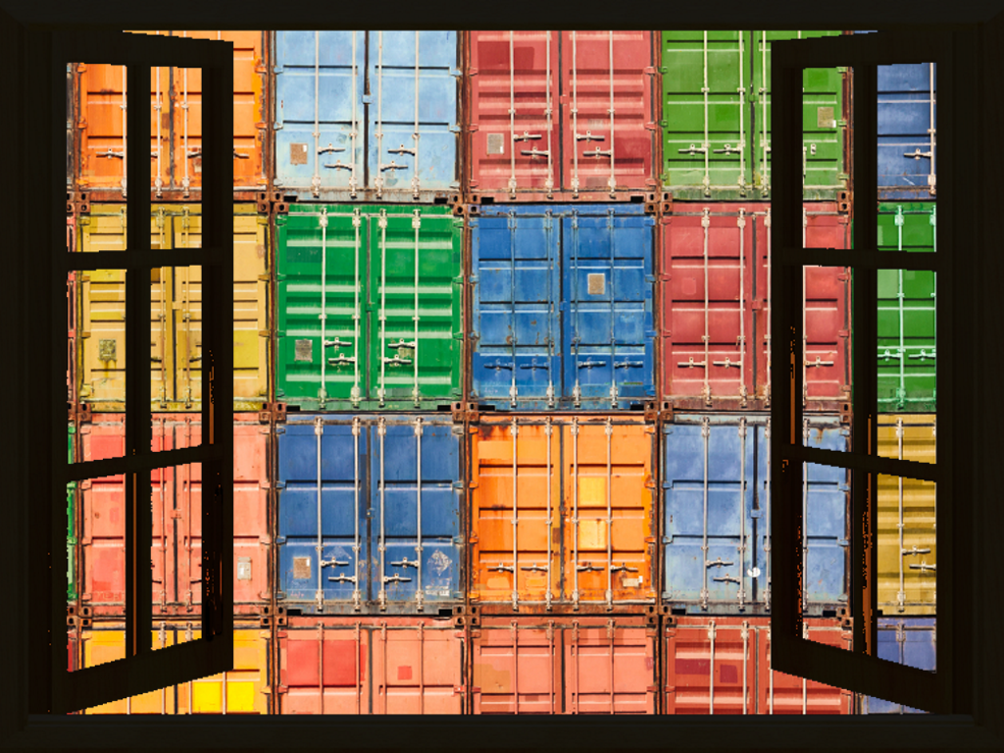
Opening Windows to Containers
Docker Toolbox (legacy)
Docker for Windows & Mac
Beta - replaces Toolbox
Does not work with Windows Containers yet
beta.docker.com
Windows Containers
Hyper-V Containers

Slide 13
“What are the core differences between Windows Containers and Hyper-V Containers?”
Trust
Hyper-V Containers - Isolation is tighter
Windows Containers – OS trusts the apps & apps trust each other
Density
Hyper-V Containers – Nesting
Platform
Windows Containers does not require Hyper-V

Slide 14
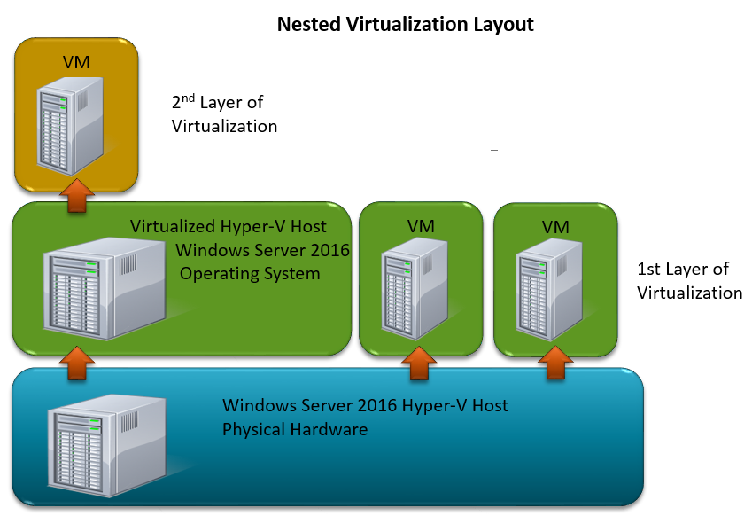
Set-VMProcessor -VMName <Target VM's Name> -ExposeVirtualizationExtensions $true
Graphic credit: www.altaro.com

Slide 15
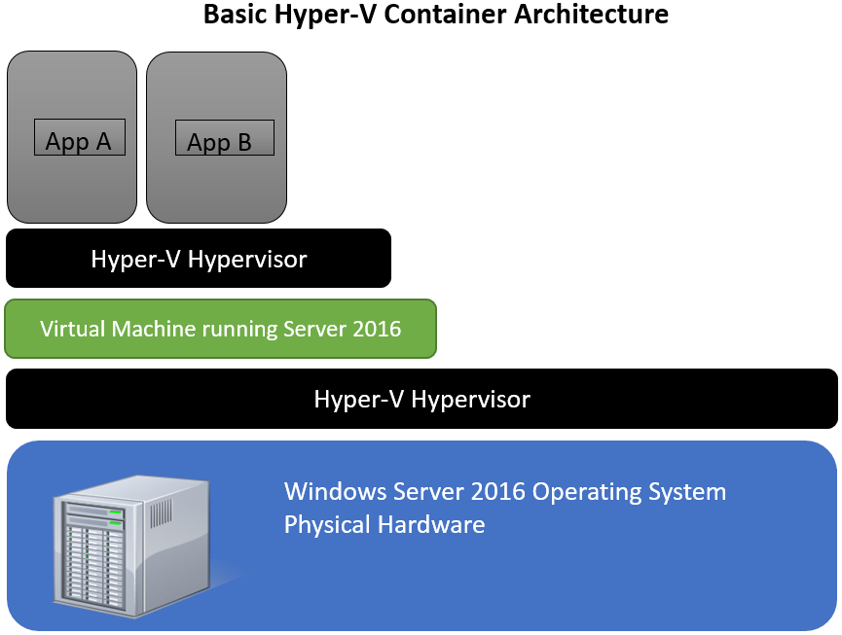
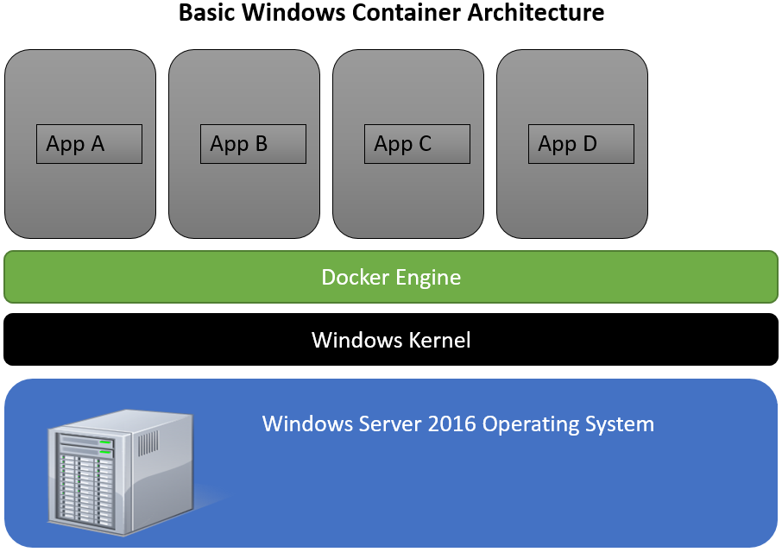
Graphic credit: www.altaro.com

Slide 16
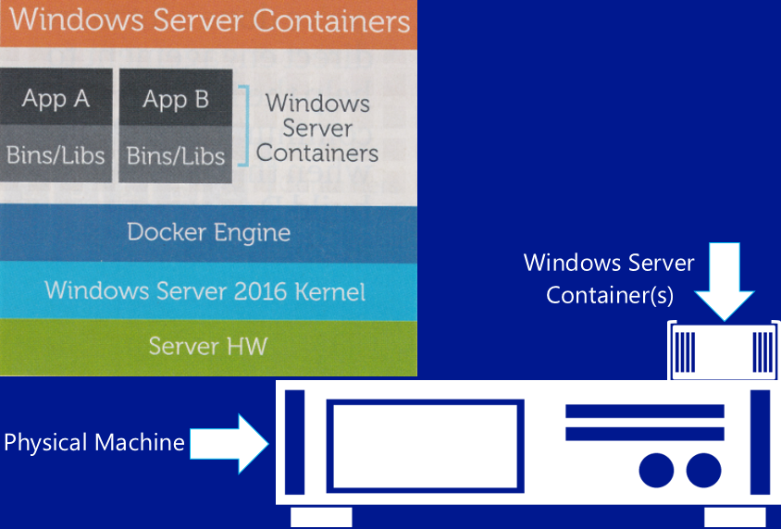
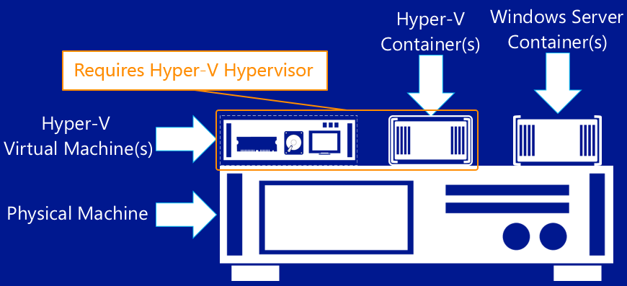
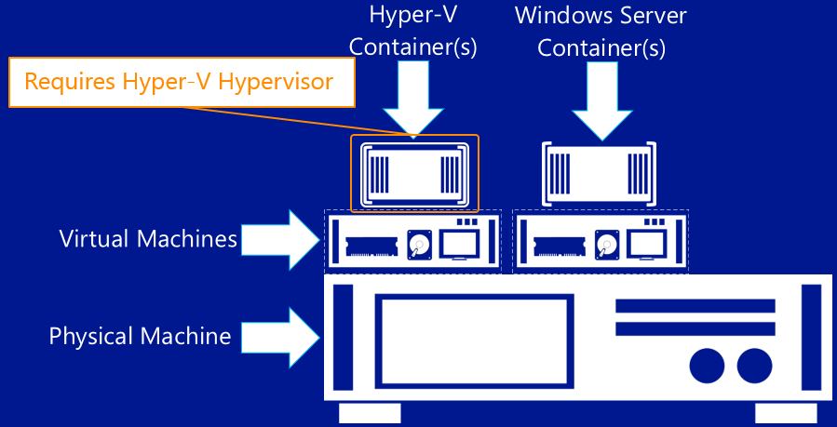
Windows Containers
Hyper-V Containers
Nested Hyper-V Containers
Graphic credit: Aiden Finn

Slide 17
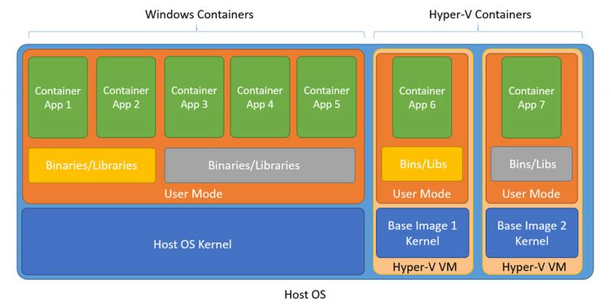

Slide 18
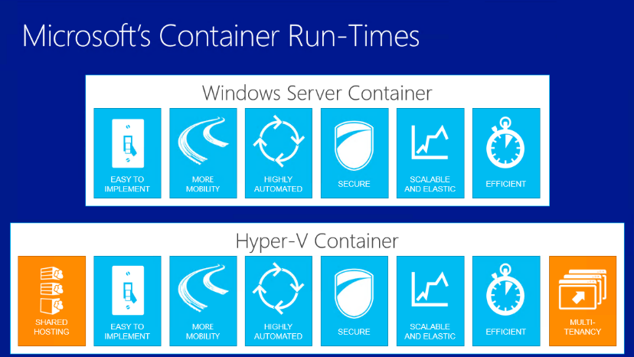
Marketing Difference?

Slide 19
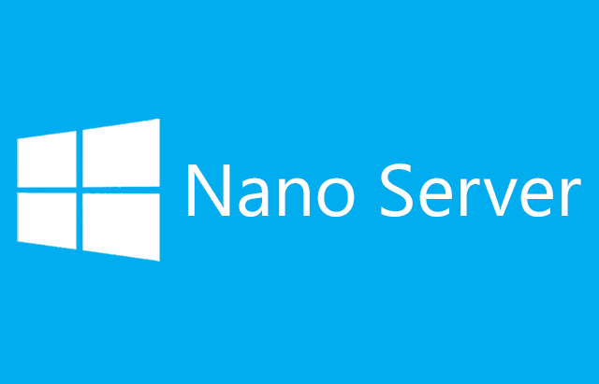
0.000.000.001
No login
No GUI
No RDP
No 32bit support
No MSI installer
One Billionth
The goal of NanoServer was for Azure & Azure Stack
NanoServer is refactored (i.e. restructured) Windows Server code
Installation is very different
There is no path from NanoServer to Core or Full
Try it out – http://aka.ms/nanoeval

Slide 20
Microvisor Architecture
Guest 1
Guest 2
Microvisor
Lightweight Linux (“Pico”)
Hardware

Slide 21
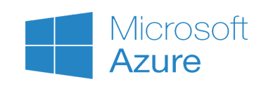
Azure Containers
Install manually on supported Linux VM’s
Docker VM Extension
Built-in to Windows Server 2016 TP
Marketplace
Pre-installed on Ubuntu
Multi-container composed apps (eg – Wordpress+mySQL)
Docker Trusted Registry, Jenkins, etc.
Azure Container Service

Slide 22


Azure Container Service (CaaS)
Streamlined provisioning of Apache Mesos Clusters
VM Scale Sets
Layered support of Swarm, Marathon, and Chronos
Docker tooling and API support
Integrated app management and scaling
Linux and Windows Server containers
Public and private cloud

Slide 23
Container Management in the Enterprise
Cluster deployment and management
Scheduling and automation
Service Discovery
Container Registry
Container placement and resource mgmt
Continuous deployment/ integration
Monitoring and Logging
Security

Slide 24
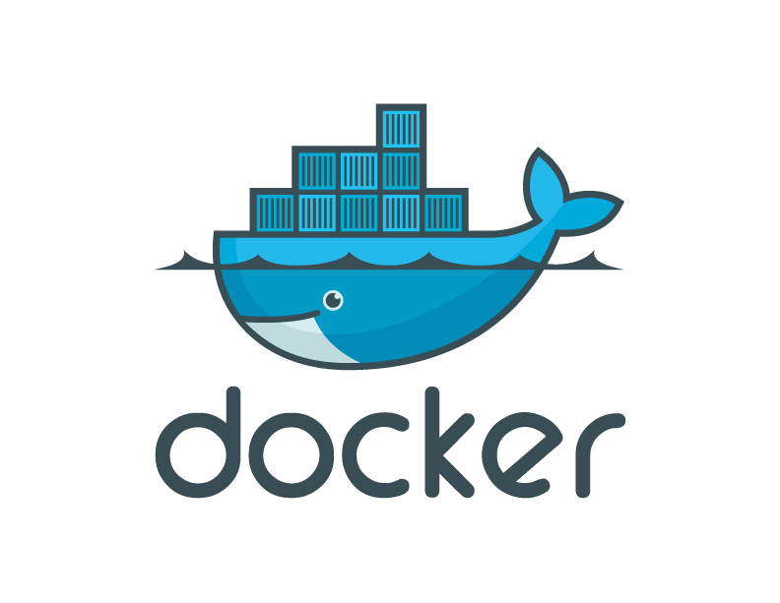
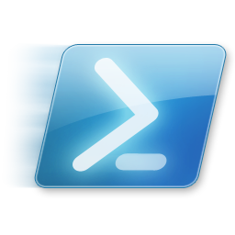

Docker & Windows Container Core Management
≠
SCVMM?
SCCM?
Intune?
5Nines?
???
Windows Containers created with Docker = must use Docker to manage
Windows Containers created with PowerShell = must use PowerShell to manage

Slide 25
DEMO TIME! Azure containers Windows containers Hyper-V containers

